Slide 1

Our Savior Ev Lutheran Church & School
Church & Family Life Center
Major Building Repairs
Open Forum June 11, 2017

Slide 2
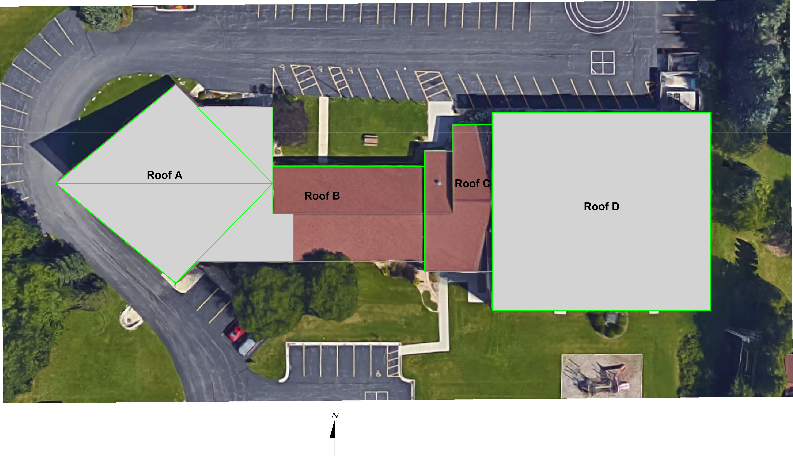

Slide 3
Church Roof History
Roof was installed in late 1994
Residential roofing system was used
Residential shingles on a tar paper underlayment
Low grade aluminum fascia & flashings were used installed with nails
Fascia boards were not sealed/coated before covering with aluminum
Overhang was coated with oil based stain
No water proof sealant was used under the flashings & up the wall

Slide 4
Church Roof Current Condition
There have been leaks on the main & lower roofs (Temporary repairs have been made)
Flashing has been reinstalled is some areas
Shingles have reached the end of the lifespan
There are soft areas of roof decking on the lower & upper roofs
Flashings are failing
Overhang is in need of recoating

Slide 6
Recommended Fix
Complete tear off roof including shingles, underlayment, aluminum fascia & flashings
Repair of any damaged roof decking
Install a new commercial roofing system
With Ice and Water Shield HT to the lower six (6) feet, perimeter gutter edge, extending down on the fascia (lower roof)
With Ice and Water Shield HT to the gable edges, on all fascia areas, including extending down under the fascia and up the backside. (upper roof)

Slide 7
Recommended Fix
With High‐Performance Synthetic Roofing Underlayment, secured with approved cap fasteners
With new drip edges, aluminum gutter apron (lower roof), pipe penetration flashings, aluminum fascia (bring it up the backside) & flashings color to match school (with Ice and Water Shield HT under)
Clean, prep and satin (oil based) the underside of the upper roof overhang with two (2) coats
Install, 50 year warranty, 250 lb., (Possible upgrade to 350 lb., w/lifetime warranty on main roof only) High-Definition color tone, A-R algae resistant fiberglass, laminated “Shake” Design, seal-down shingles. Applied in accordance with the manufacturer’s specifications, to cover the entire roof area.

Slide 8
Recommended Fix
Install water diverters above the two (2) doorway areas
With a warranty on this job against leakage for a period of five (5) years under normal conditions of wear, tear and weather. The warranty covers Workmanship & Material

Slide 9
Family Life Center Masonry & Roof History
Family Life Center was completed in 2008
There were water issues from the beginning, builder covered ~ $43K in repairs/improvements
OS has done ~ $9K in repairs in the last few years (~ $3800 will be reimbursed by builder)

Slide 12
Family Life Center Masonry Recommended Fix
Install End Dams at the Metal Panels (Cost will be covered by Builder)
Recaulk Expansion Joints, Doors and Windows in the Concrete Block Area
Pressure wash, chemical clean block & install One Coat of Porous Block Treatment (This will need to be redone in about 8 years)
Interior Masonry Repairs in Gymnasium, including expansion joints, cracks & broken block

Slide 13
Family Life Center Masonry Recommended Fix
Exterior work cannot be completed until the new gutter system is installed
Interior & exterior paint will be done by OS members
Cleaning of gym after repairs will be done by OS members

Slide 14
Family Life Center Roof Recommended Fix
New commercial rubber roofing system
With Insulation Board over existing standing metal seam roof
With ½” HD coverboard over insulation per manufacturer recommendations on fasteners
With a fully-adhered single ply 60mil rubber roof membrane over coverboard (will need to be inspected very 5 years)
With a new gutter and three (3) downspout assemblies, including a new, oversized, pre-finished, aluminum gutter apron along the east edge of roof, pitched to the SE corner of facility

Slide 15
Family Life Center Roof Recommended Fix
With a warranty on this job against leakage for a period of five (5) years under normal conditions of wear, tear and weather. The warranty covers Workmanship & Material
With new ice melt system (to be installed by Electrical Contractor)
Extending of downspouts to the drainage pond on the SE corner of the property (to be done by OS members)

Slide 16
Project Costs
Church Roof ~ $51K (+ ~ $2500 for shingle upgrade)
Family Life Center Masonry ~ $19K (~ $5500 to be covered by Builder)
Family Life Center Roof ~ $66K
Total Cost ~ $137K (- ~ $9200 reimbursement from Builder)
Includes a 15% contingency (Repair/replacement of any damaged roof decking would be covered with contingency)

Slide 17
Possible Project Schedule
Voter approval on June 25, 2017
Work to start ~ Late summer/early Fall, 2017
Masonry work to be completed by August, 2017 (except pressure washing/chemical cleaning & Porous Block Treatment )
Major work to be completed by late November, 2017

Slide 18
Financing Plan/Options
Stewardship Appeal-with possible matching funds
Member Loan Program
Borrowing for Internal Funds
Delay Portions of Project

Slide 19
Questions

